Slide 1
Topcoder Smart OPs
2024
https://www.topcoder.com/business-process/reinventing-the-back-office-with-smart-operations/

Slide 2

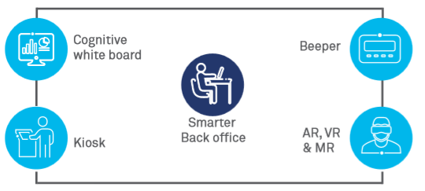
Smart OPS
Smart–Ops is is the next logical step towards futuristic re-engineering aimed at reimagining back-office operations

Slide 3
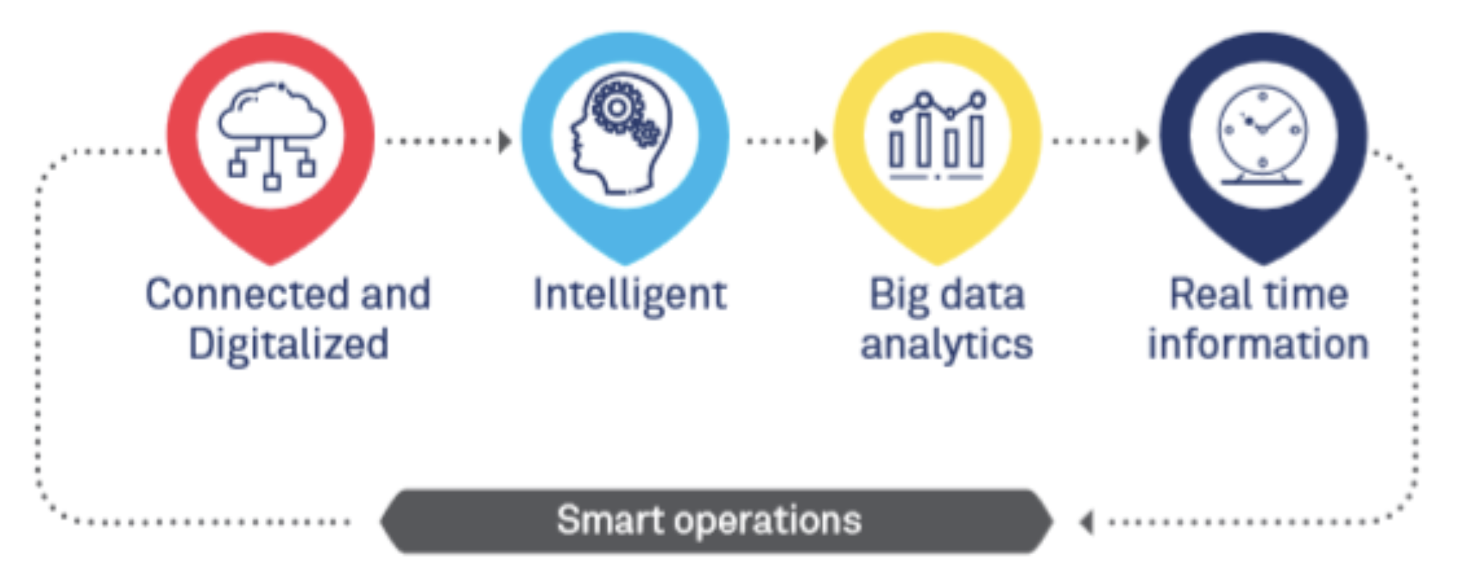
Characteristics of Smart Operations

Slide 4
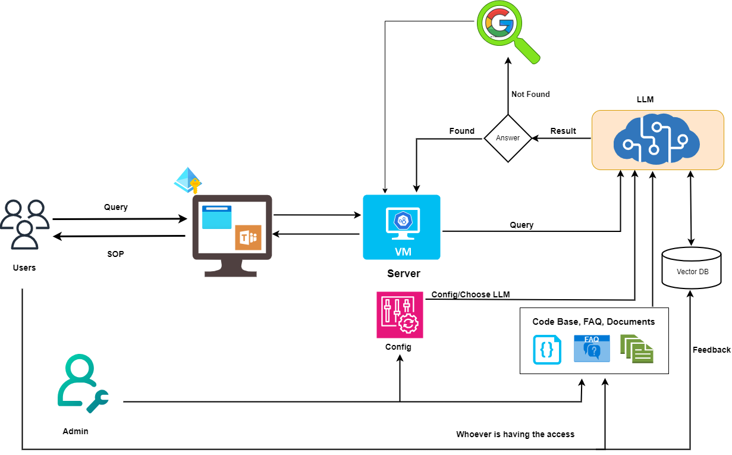
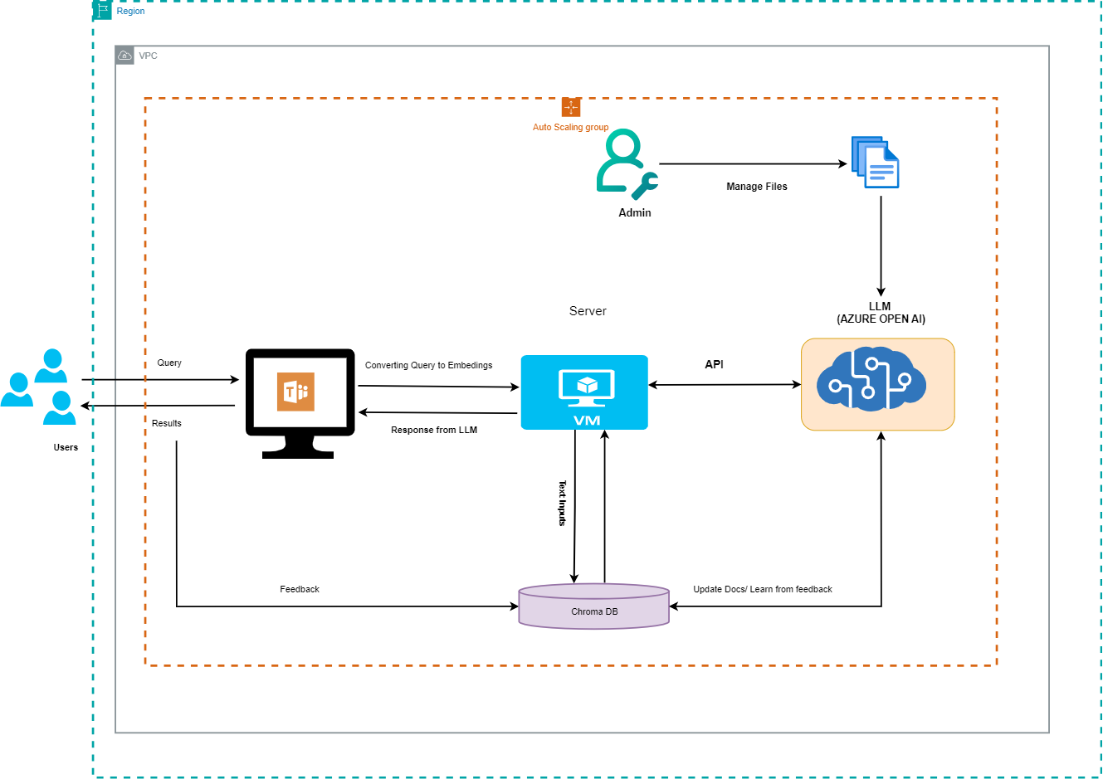
Architecture

Slide 5
Thank you!

